Slide 1
Data Structure and Algorithm
COURSE CODE: CS-201
TOPIC: DYNAMIC MEMORY ALLOCATION
COURSE INSTRUCTOR: HABIBA ARSHAD

Slide 2
Goals for today
To introduce :
  Dynamic Memory allocation

Slide 3
Memory Management with Pointers
The process of allocating and de-allocating memory is known as memory management.
Static Memory Allocation
Memory is allocated at compilation time
Dynamic Memory
Memory is allocated at running time

Slide 4
Static memory allocation
Memory to be allocated is specified while writing programs
      int i , j , k ;
      char name[ 20 ];
Class average example
      int main()
      {
      int n;
      cout << "Enter number of student" << endl;
      cin >> n;
      int age[n];
      }
Above approach has so many disadvantages

Slide 5
Dynamic memory allocation
Memory is allocated from Heap
Pointer is returned
Void Pointer
    void* ptr;
Type casting
    (int*) ptr; //*ptr without casting is error
Null pointer
Notes:
Heap is a type of data structures
Follows the rule of complete binary tree.

Slide 6
Colloc
“calloc” or “contiguous allocation” method in C is used to dynamically allocate the specified number of blocks of memory of the specified type. It is very much similar to malloc() but has two different points and these are:
It initializes each block with a default value ‘0’.
It has two parameters or arguments as compare to malloc().
Syntax:
ptr = (cast-type*)calloc(n, element-size);
here, n is the no. of elements and element-size is the size of each element.

Slide 7
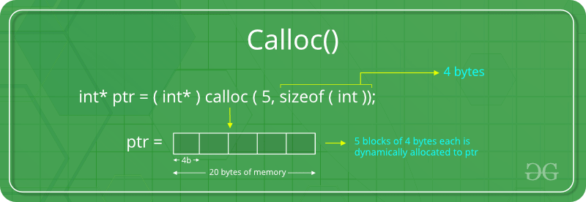
Colloc

Slide 8
Allocating memory dynamically
Calloc function
  Arguments
    Number of elements
    Size of each element
  Example
    calloc( 10, 4) ; // 10 ints x 4 bytes each
    calloc( 10, sizeof ( int ) ) ;
    (int*) calloc ( 1000 , sizeof ( int ) ) ;
Is required memory always available ?
Check if memory is allocated or not.
Notes:
Malloc() function will create a single block of memory of size specified by the user. Calloc() function can assign multiple blocks of memory for a variable. Malloc function contains garbage value. The memory block allocated by a calloc function is always initialized to zero.

Slide 9
malloc ()
The “malloc” or “memory allocation” method in C is used to dynamically allocate a single large block of memory with the specified size.
It returns a pointer of type void which can be cast into a pointer of any form.
It doesn’t initialize memory at execution time so that it has initialized each block with the default garbage value initially.
Syntax:
ptr = (cast-type*) malloc(byte-size)
For Example:

Slide 10
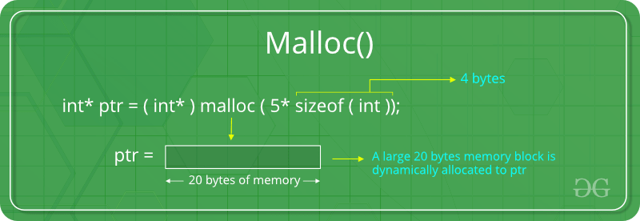
malloc ()

Slide 11
Increase the allocated memory (realloc)
“realloc” or “re-allocation” method in C is used to dynamically change the memory allocation of a previously allocated memory.
In other words, if the memory previously allocated with the help of malloc or calloc is insufficient, realloc can be used to dynamically re-allocate memory.
re-allocation of memory maintains the already present value and new blocks will be initialized with the default garbage value.
Syntax:
ptr = realloc(ptr, newSize);
where ptr is reallocated with new size 'newSize'.

Slide 12
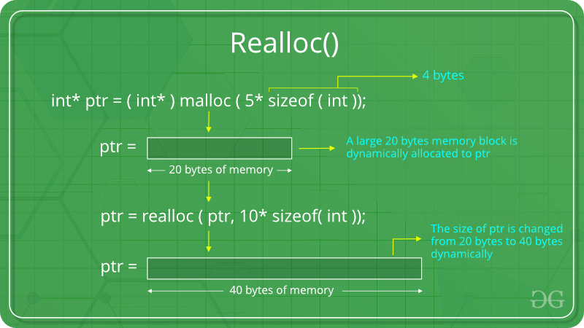

Slide 13
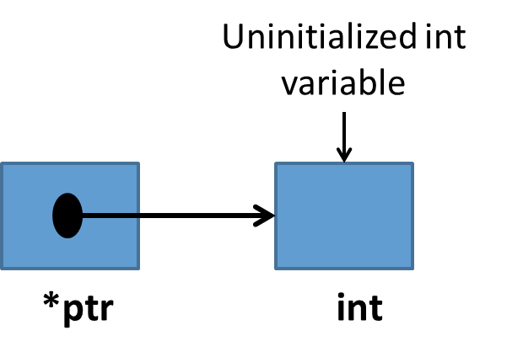
new and delete keywords
New is used to allocate memory dynamically
      int*p; // declares an int pointer
      p =new int; // dynamically allocate memory using new
      *p = 10 // assign value to allocated memory
delete is used to release the allocated memory
      delete p;
      delete[] name;
      delete str;

Slide 14
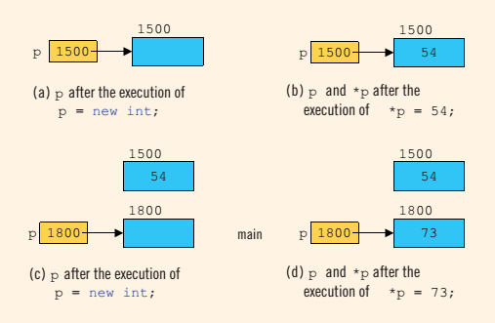
new keyword

Slide 15
Problems with DMA
Memory leak
  Memory allocated but not released properly
Dangling Pointers
  Pointer pointing to illegal memory

Slide 16
Points to ponder
Using dynamic memory is more efficient than the static memory.
Immediately after a memory allocation call, check whether the memory has allocated successfully.
Whenever possible free the allocated memory in the same function.
Be careful about memory management to prevent memory leakage and dangling pointers.
Before exiting the program, make sure that the allocated memory has freed.

Slide 17
Questions?

